Slide 1
My future profession
Work of Maksimov Alexey student of 8A grade

Slide 2
Software developer
Being software developer a.k.a. coder seems to be really interesting for me. I knew C++ when I was in 3-4 grade. I was interested in coding because I wanted to make games and computer viruses.

Slide 3
Required skills
Good understanding of math
A bit of psychology (To know how to make things understandable and intuitive)
UI Designing
Understanding of algorithms (Dijkstra, Shell sort)
English language

Slide 4
Advantages of profession
Being software developer is well paid
It seems to be enjoyable
You can work from anywhere. All you need is one laptop and the internet connection.
You always keep on learning new things in your office, in your project. Your knowledge increases with your experience.

Slide 5
Disadvantages
You have to upgrade your skills continuously(I’m not sure is it disadvantage)
You need to sit and sit and sit (After 8 hrs of sitting it gets uncomfortable)
There is there too much competition because they can work threw internet

Slide 6
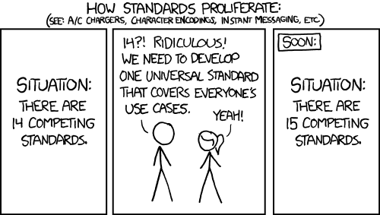
Why is there too many programming languages

Slide 7
Why I have chosen this profession
That was fun for me. Especially game development
This is how I can help myself to make something monotonous (like copying files, pressing buttons and etc.)

Slide 8
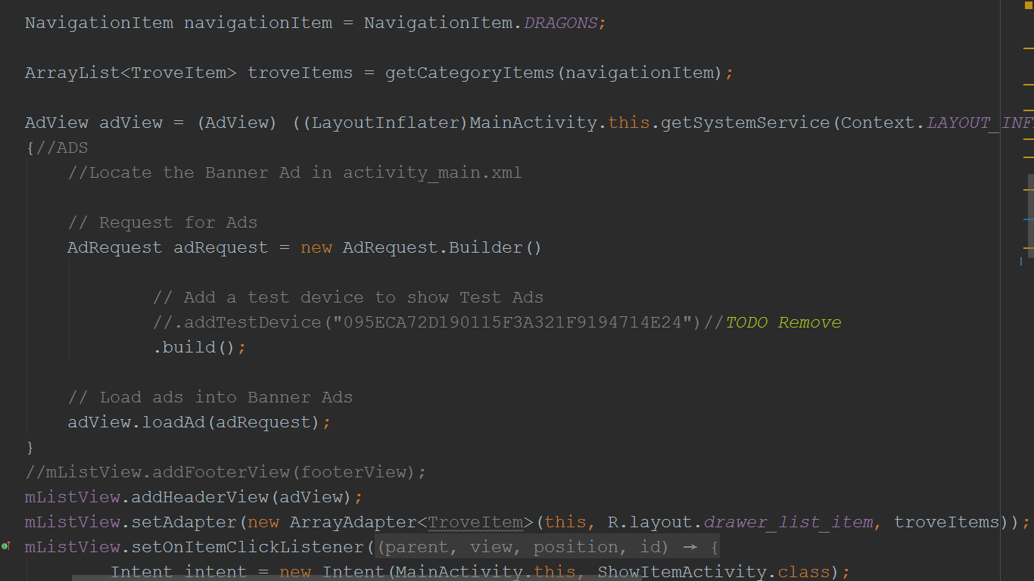
Thank for your patience

